Slide 1



eग्रामपंचायत
One step towards आत्मनिर्भर भारत

Slide 2
Project Guide: Ms. Anagha N. Chaudhari. Team Members: Rohit Naikade (339) Mehul Lokhande (331) Vijay Dabhade (308) Govind Madankar (332)
Topic: eGramPanchayat.
Department Of
Computer Engineering.
Academic Year:2020-21.
Semester:V

Slide 3
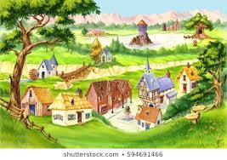
—Mahatma Gandhi,
Nationalist, and Political Leader
“
Let the villages of the future live in our imagination, so that we might one day come to live in them!

Slide 4
Index.
4
Sr.No. | Slide Name. | Page No.
1. | Problems & solutions for traditional system. | 5-6
2. | Scope of project. | 7-8
3. | Actors & stake holders. | 9-10
4. | Functional & Non-functional requirements. | 11-12
5. | Software development life cycle. | 13
6. | UML Diagrams. | 14-20
7. | Project Plan & high level view. | 21-22
8. | Industry collaboration. | 23
9. | Implementation status. | 24-26
10. | Technology stack & Advantages. | 27-28
11. | Conclusion & references. | 30-31
12. | Suggestions. | 32

Slide 5
Problems faced by traditional System.
5
Following problems encoutered in traditional system of Grampanchayat:
Records of revenue taxes paid by villagers are maintained by paper work.
People don’t follow deadlines to pay revenue taxes.
Workers of Gram Panchayat have to circulate bills of revenue taxes by visiting each house.
Need to visit panchayat office no. of times for resedential certificate.
No awareness about latest schemes of govt. for farmers,villagers.
Quarrels between villagers and officer if any record has been missed out.

Slide 6
Solutions from our system.
6
Features of our system to overcome those problems:
Online and secure payment gateway to pay revenue taxes online.
Provide receipt of payment in pdf format.
Floating a govt. schemes on website to provide awareness among villagers.
Admin dashboard to maintain transaction data of revenue taxes and decide revenue taxes.
Villagers can apply for residential certificate online.
Villagers will get certificate through email after complete process.

Slide 7



Scope of project.
Short-term goals
Limitations
Milestones
7
Develop a secured web application for revenue payments.
Need of large database, uneducated villagers, security of payments.
Develop a notification floating system and certificate approval module and get approval from govt. to use in grampanchayat.

Slide 8


Scope of project.
Top-level requirements
Future Scope
8
Large no. of user’s document verification for residential certificate, advanced payment gateway.
Develop a Integrated system to function for all gram panchayat offices in disctrict.

Slide 9
Stakeholders.
01
02
03
9
Villagers end users.
Gram-Panchayat officers.
Government officials as organizations.

Slide 10

Actors.
01
02
03
10
Villagers as end users.
Applicants for Residential Certificate.
Developers as Team members.

Slide 11
FUNCTIONAL REQUIREMENTS.
Database:
To store user. credentials(username,password).
To store Applicant details.
To store feedbacks.
Login/Register Page.
To make new account for new users.
To give access to users with valid credentials.
GUI:
Dashboard.
Stastical Charts.
Google maps widget.
Network:
Server for managing dynamic data.
Client-server architecture.
Server:
To render user requests.
API Routing.

Slide 12

NON-FUNCTIONAL REQUIREMENTS.
Security:
Login credentials to enter into portal.
Provide easy login with oAuth parties like google and facebook.
Reliability:
Validations in case of form credentials entered.
Must handle load during high traffic.
Can run on any device resolution.
Maintainability:
Admin Dashboard.
Feedback System.

Slide 13
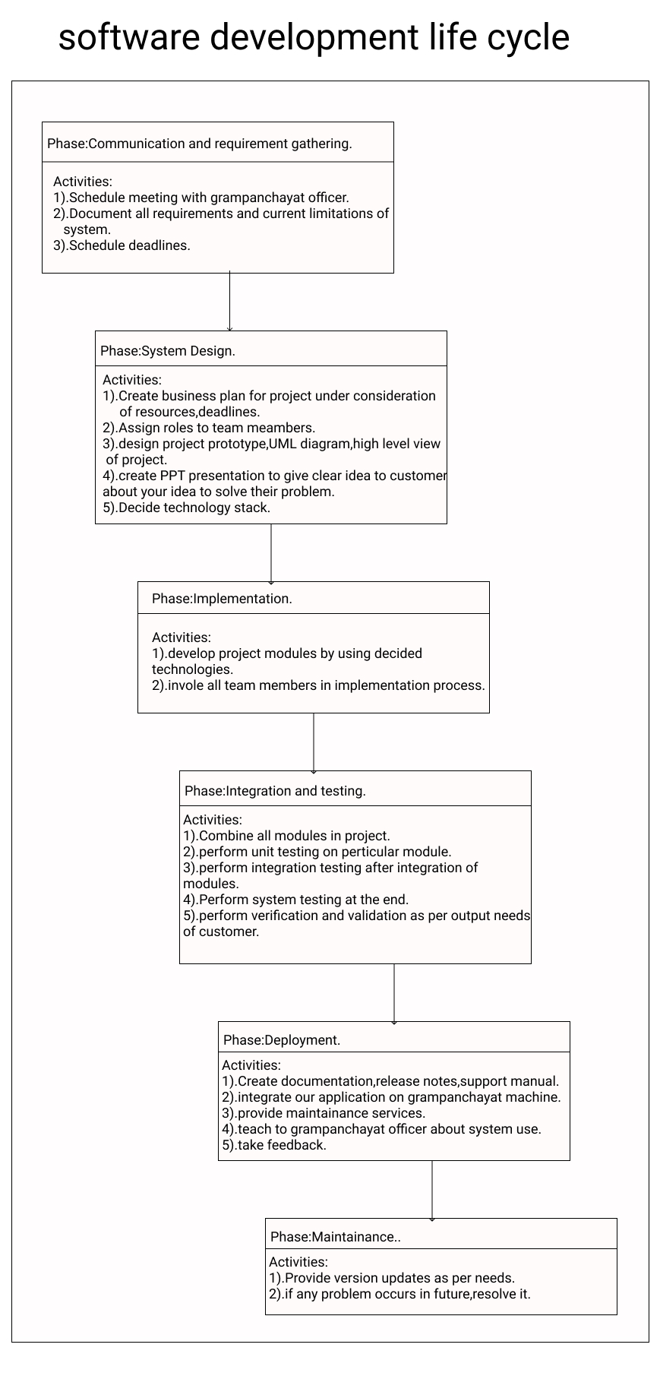
Software Devlopment Life Cycle

Slide 14
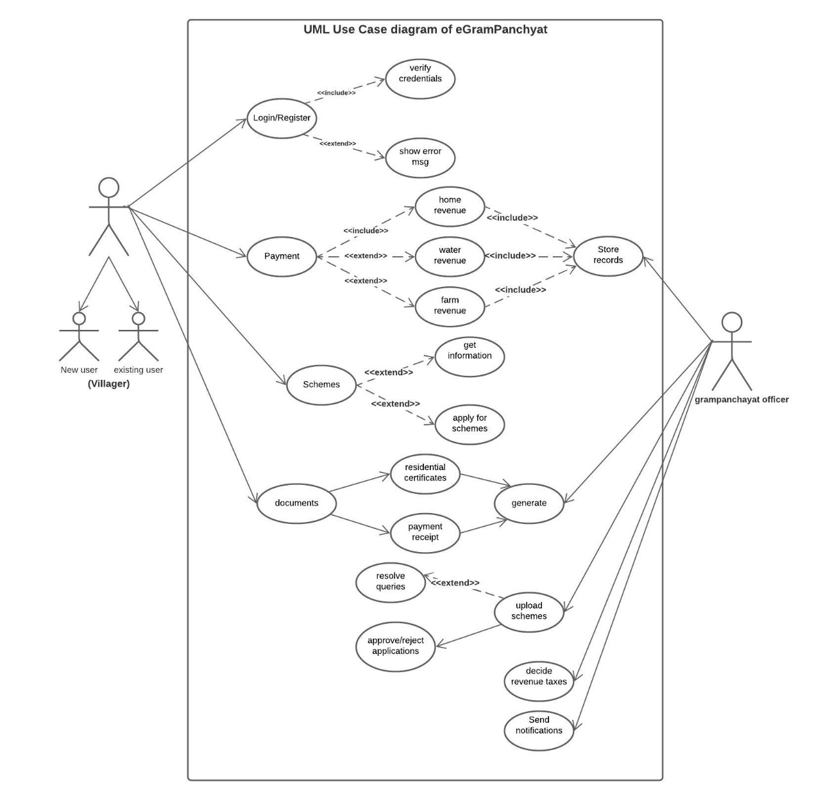
UML use case Diagram of eGram -Panchayat

Slide 15
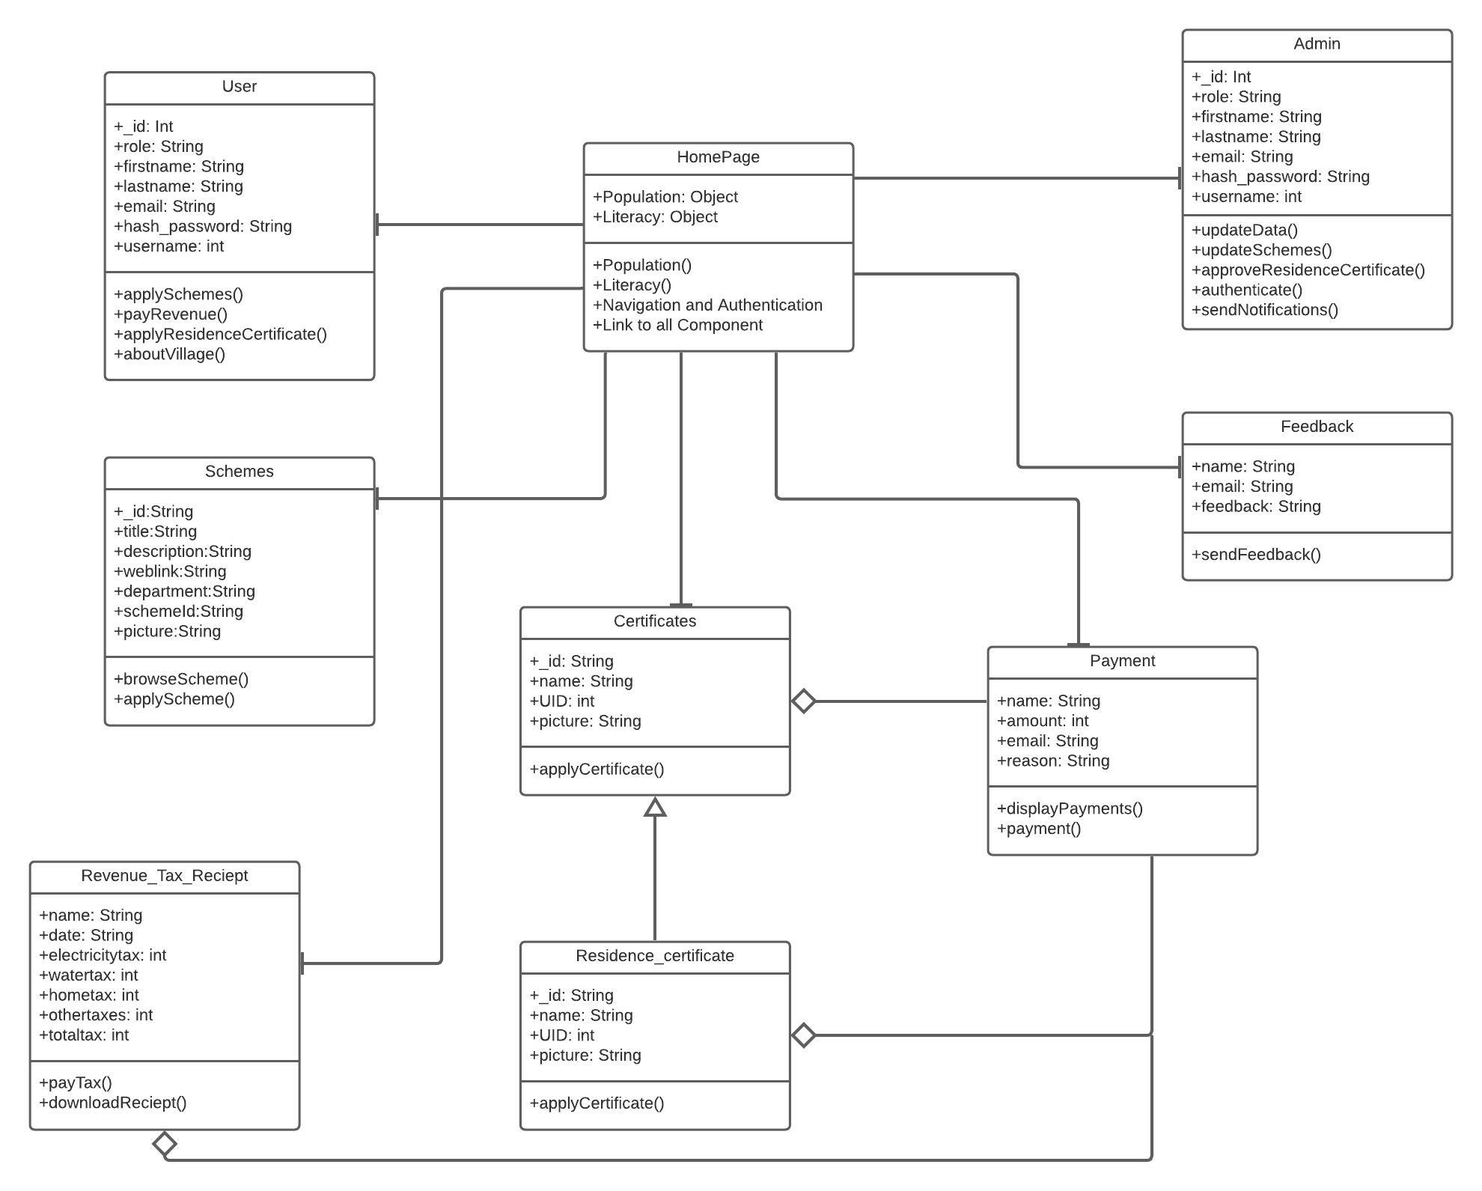
UML Class diagram.
15

Slide 16
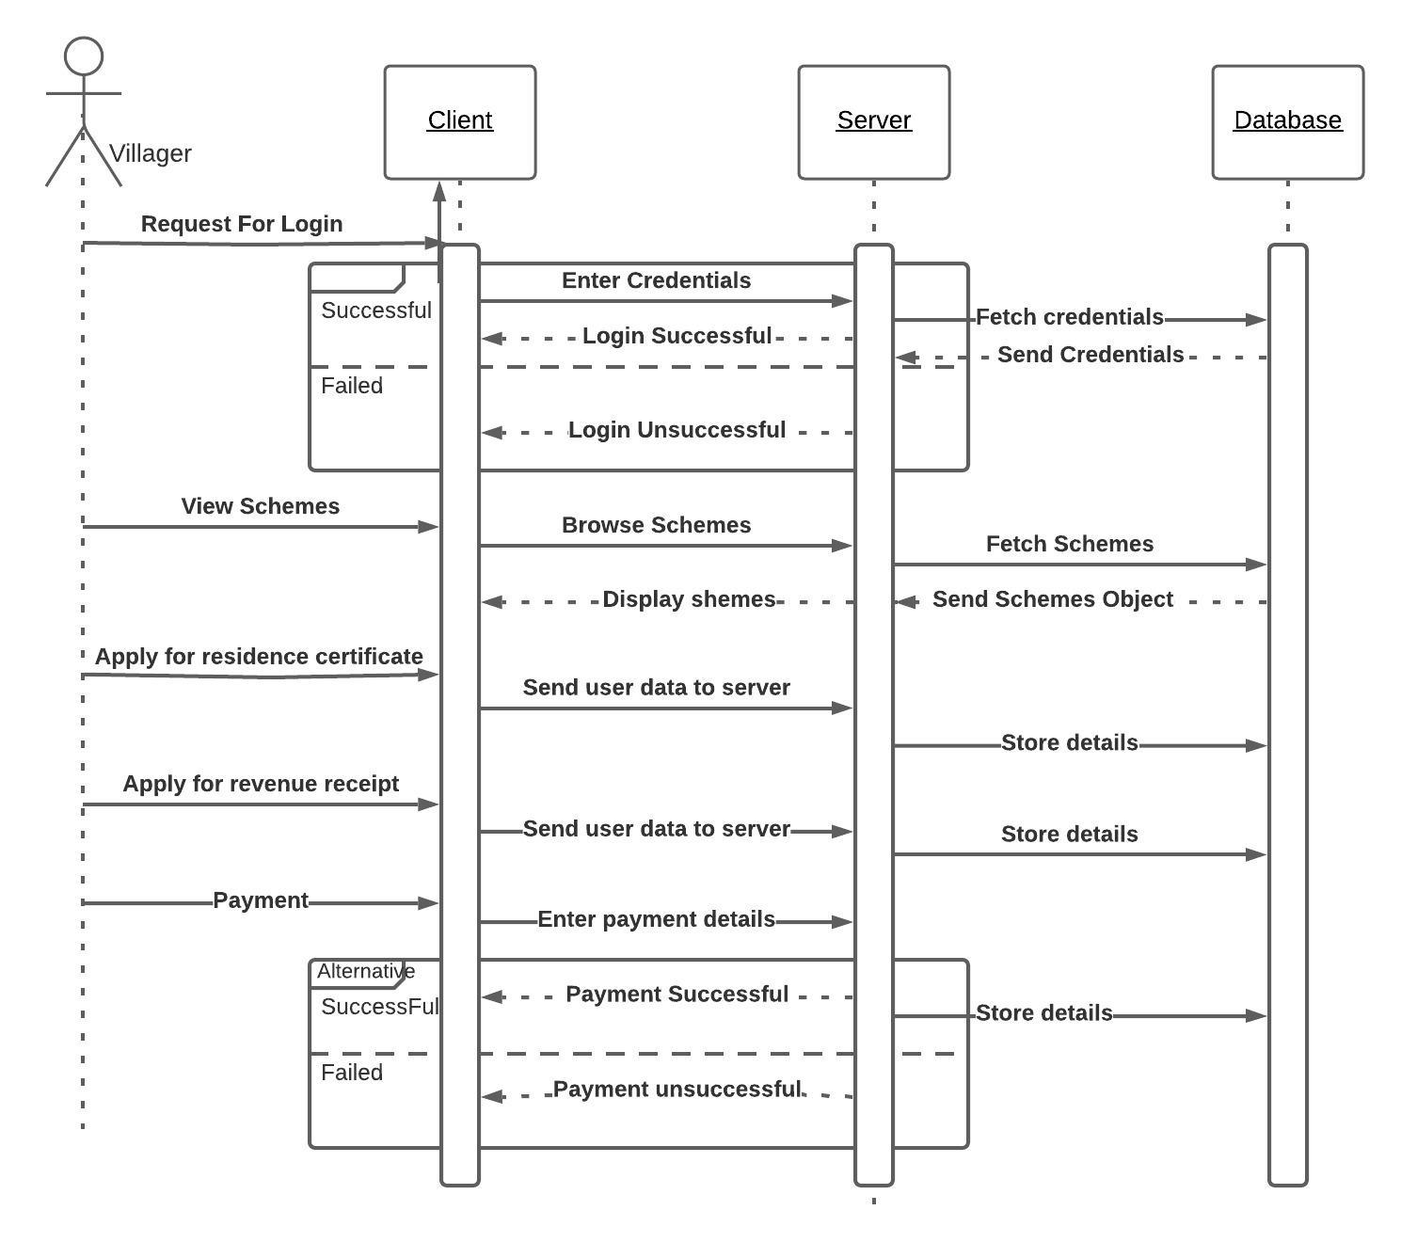
Sequence diagram for Villager.
16

Slide 17
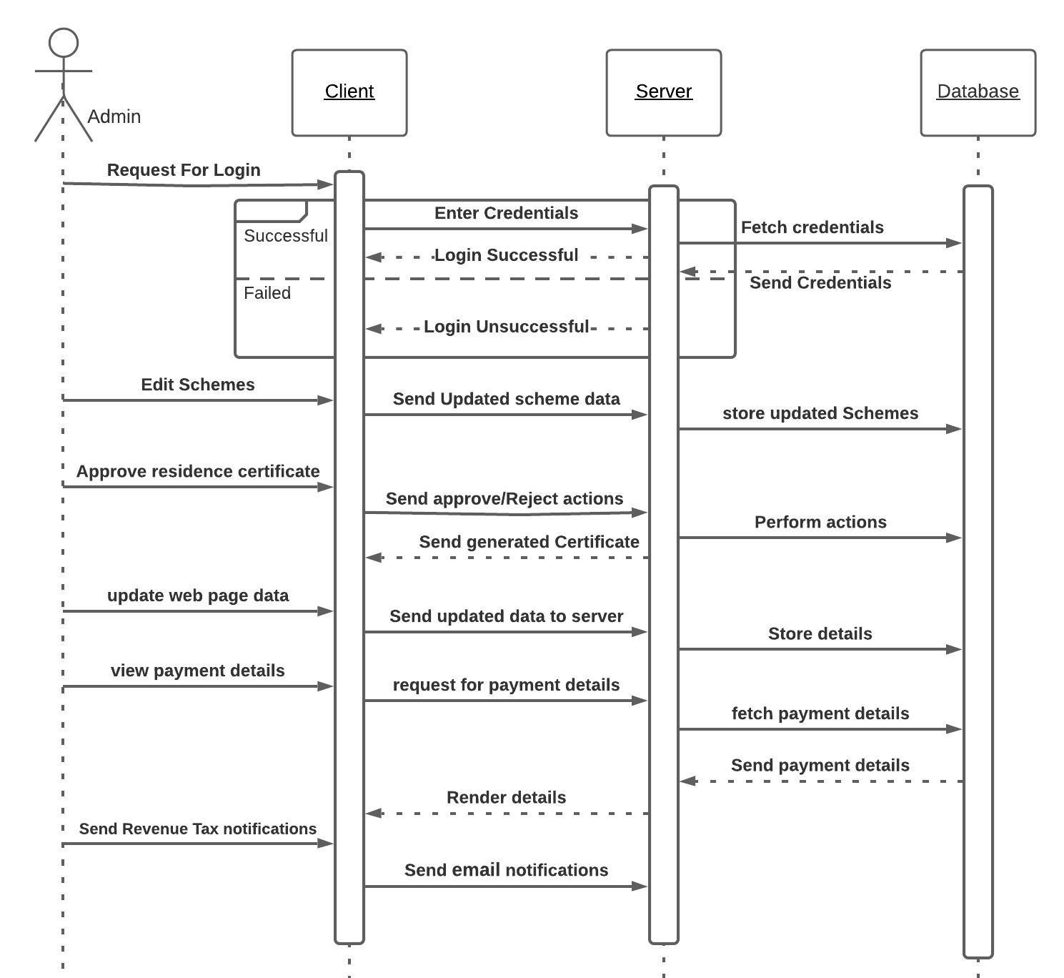
Sequence diagram for Admin.
17

Slide 18
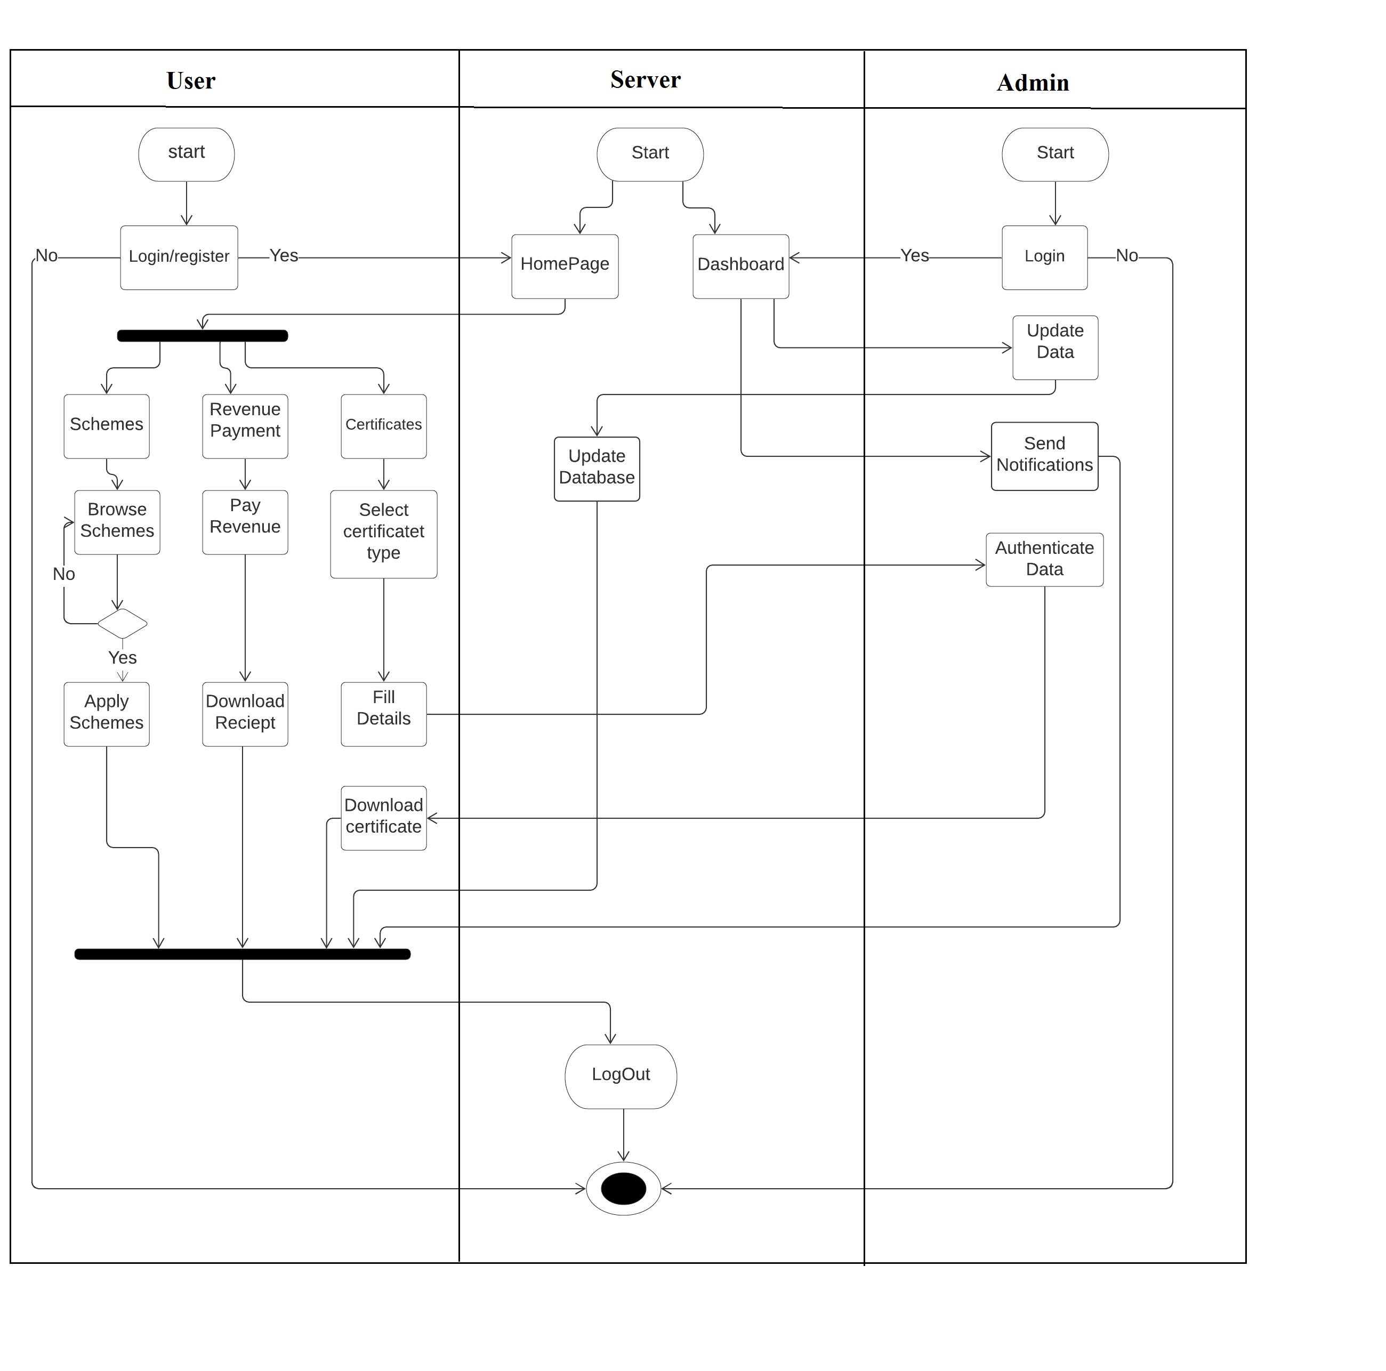
Activity diagram.
18

Slide 19
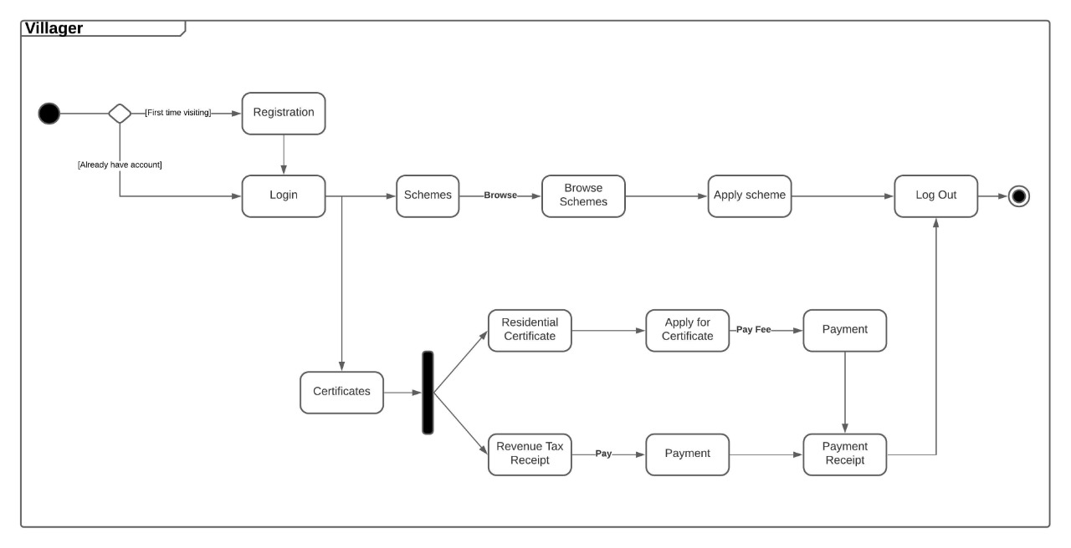
State diagram for villager.
19

Slide 20
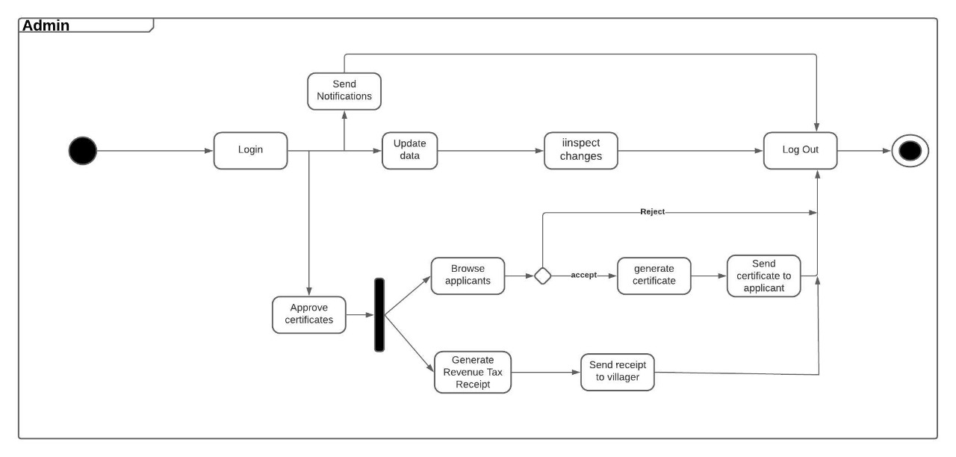
State diagram for Admin.
20

Slide 21
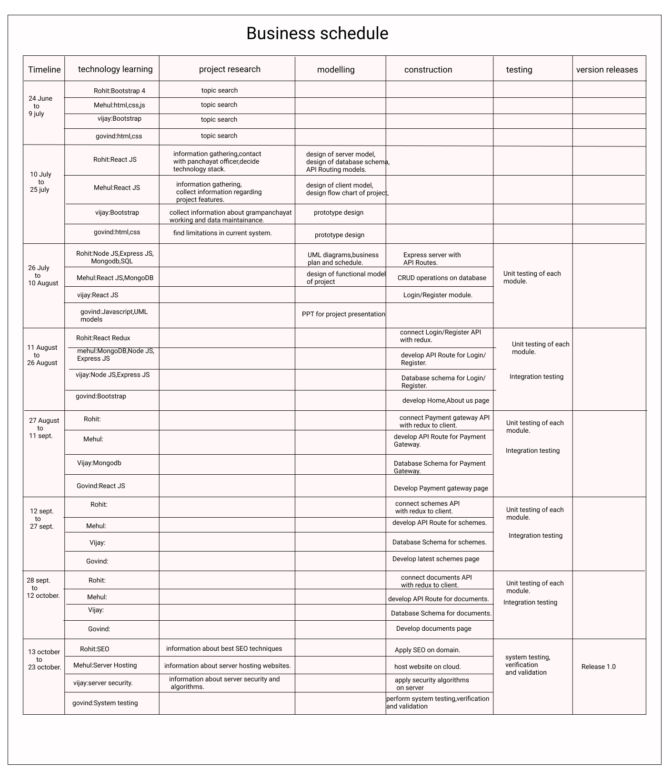
Project plan of eGram-Panchayat

Slide 22
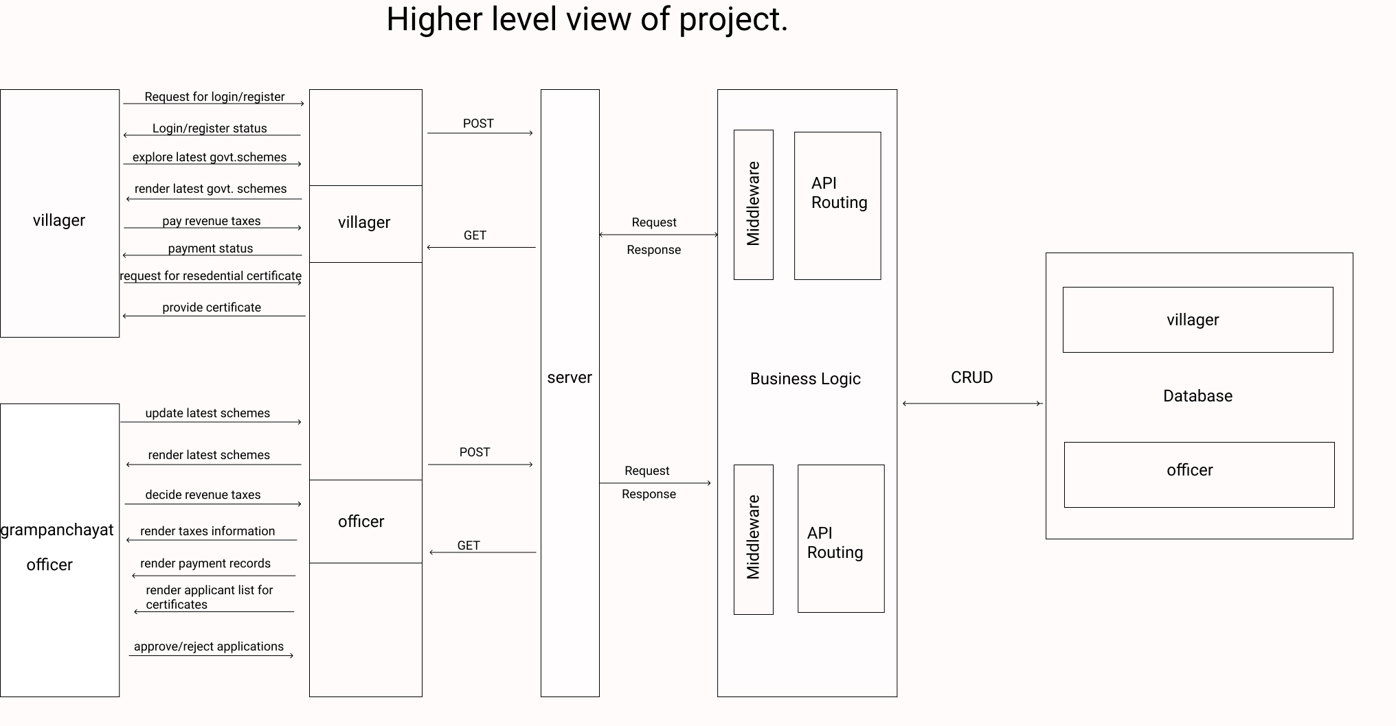
Higher Level View of project
22

Slide 23
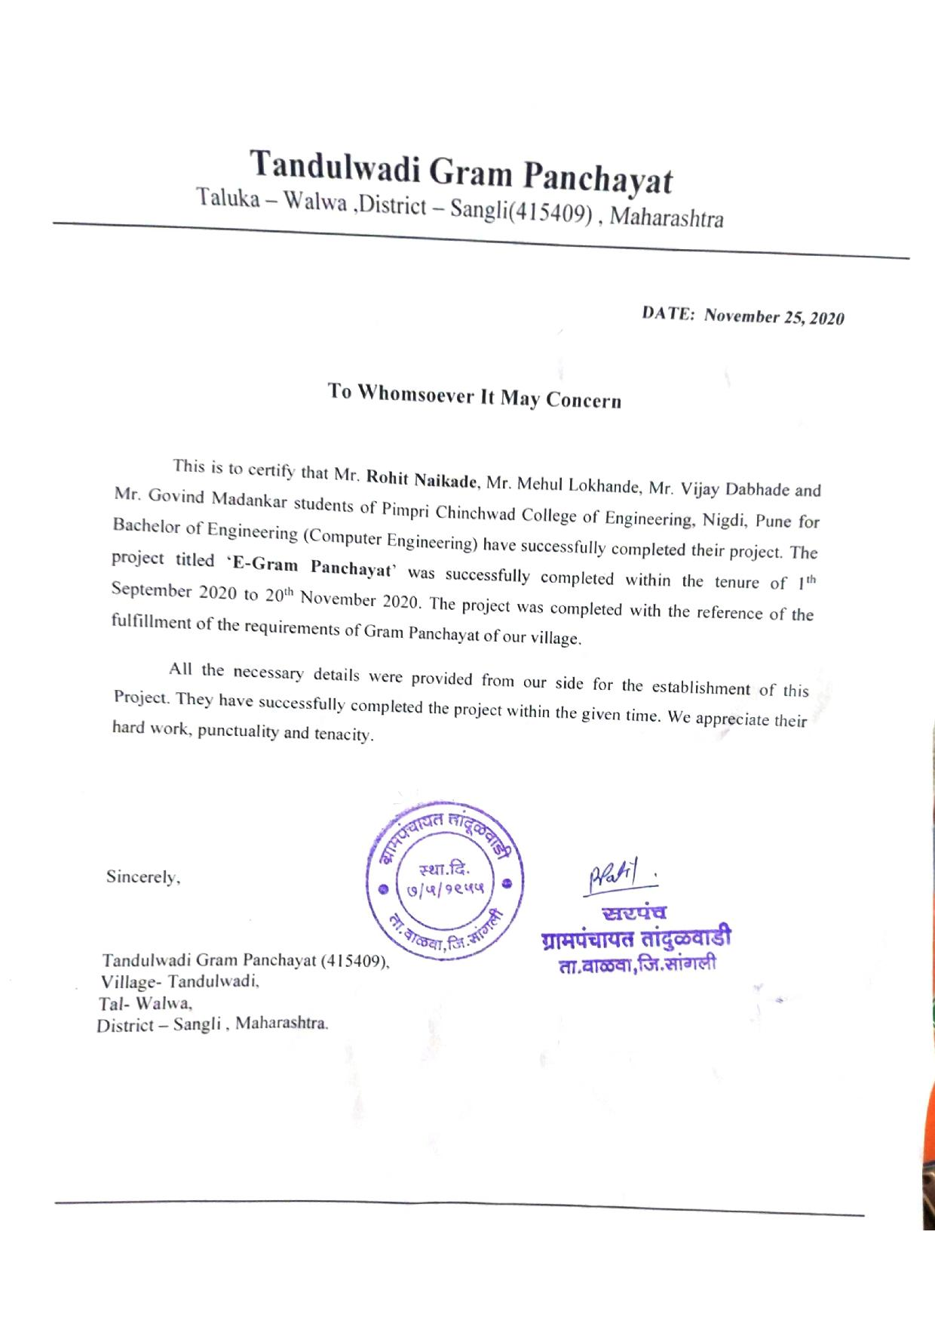
Industry Collaboration.

Slide 24
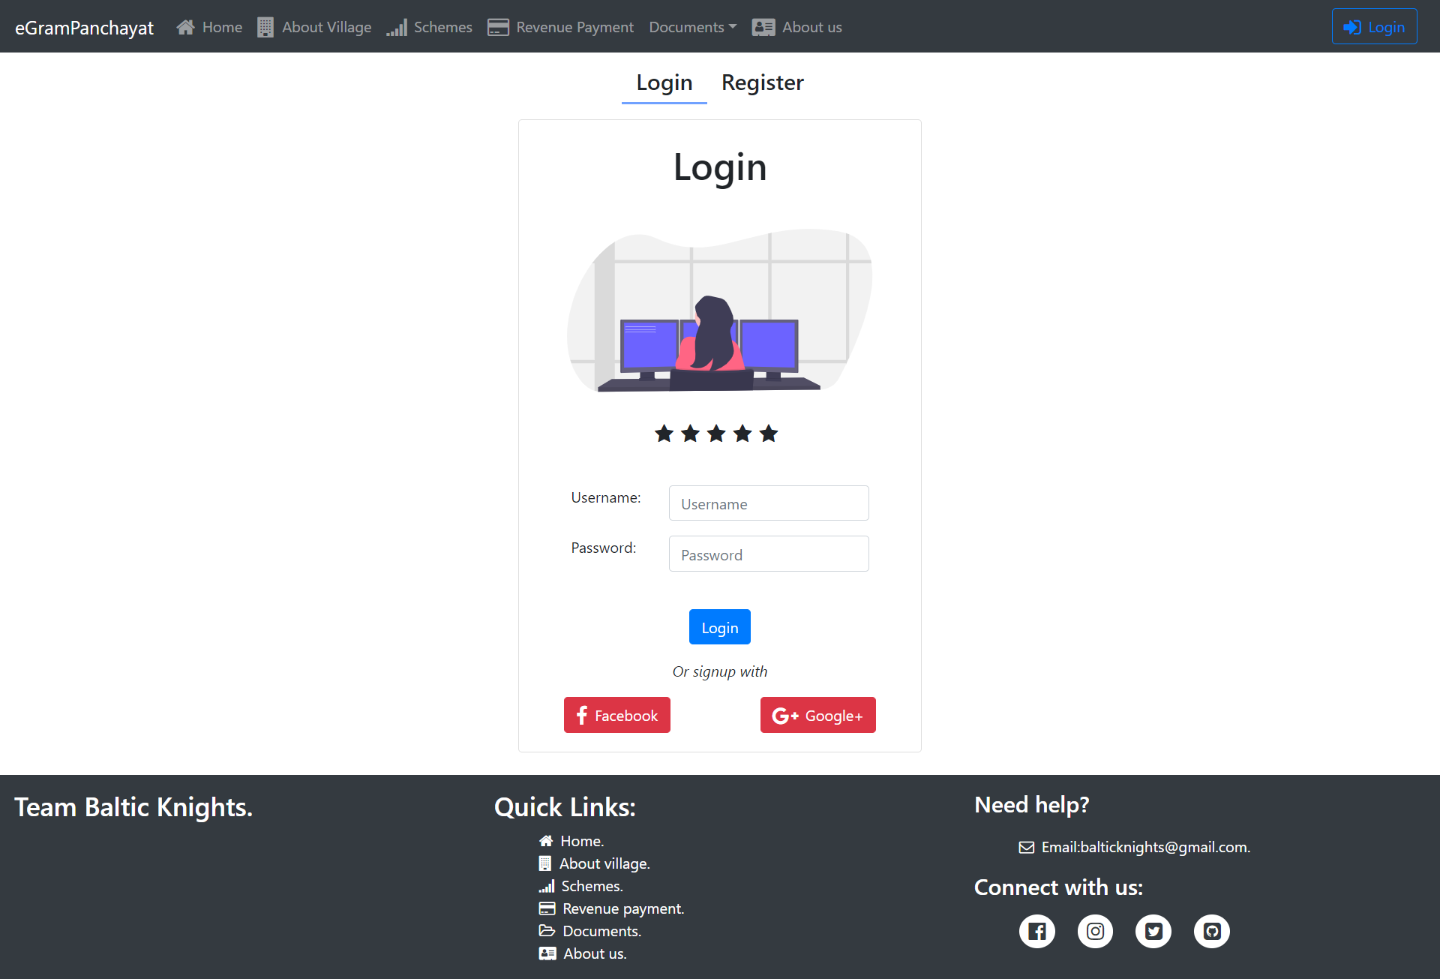
Prototype (Login Page)
24

Slide 25
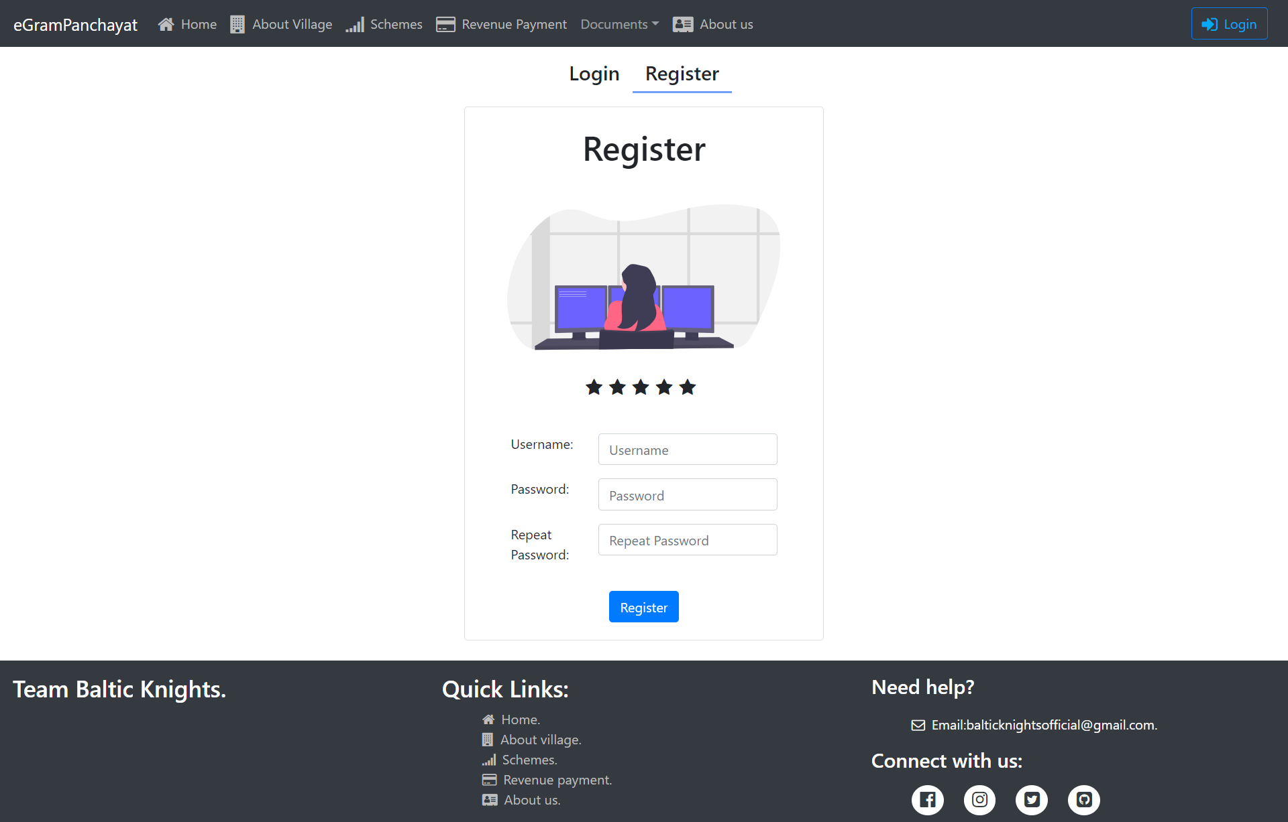
Prototype (Register Page).
25

Slide 26
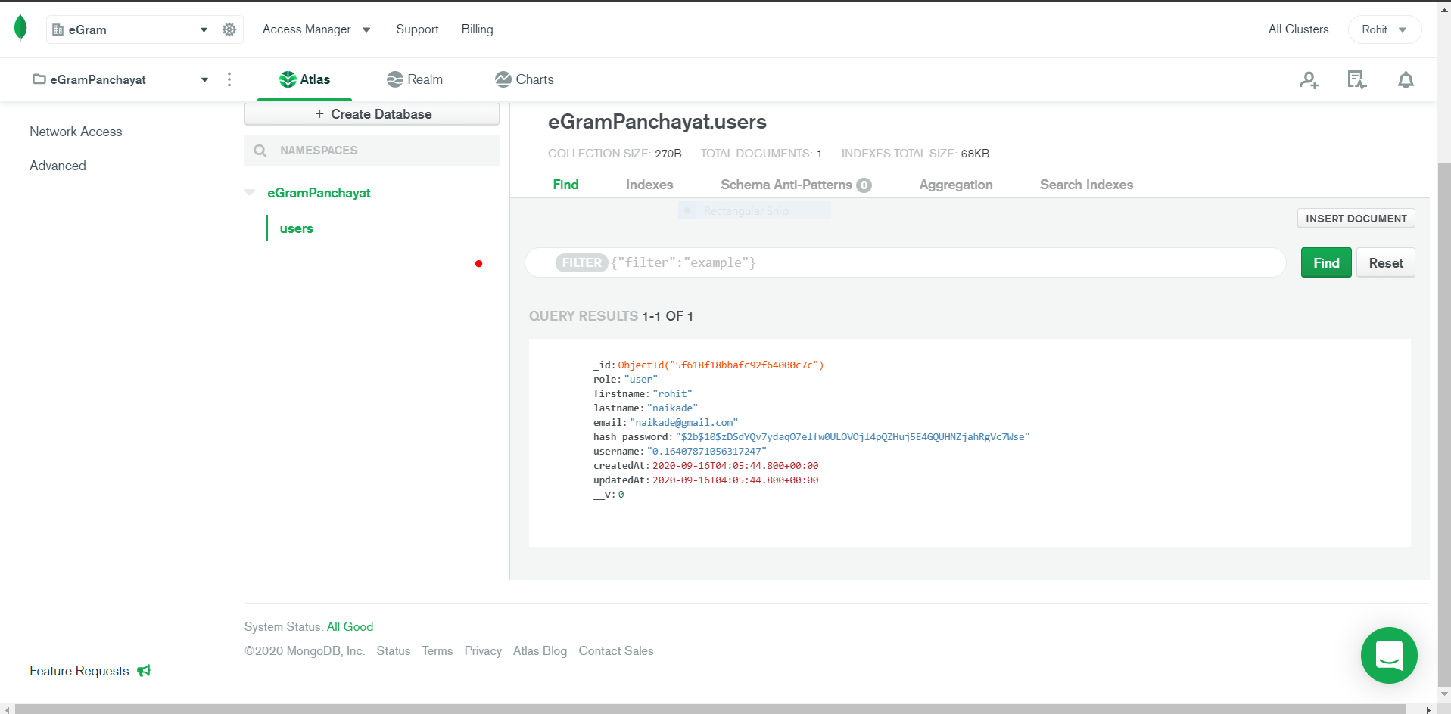
Database schema for login module.
26

Slide 27
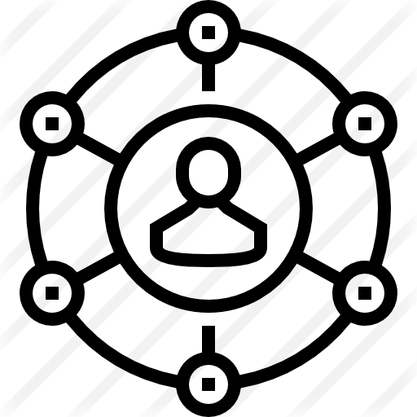

TECHNOLOGY STACK.
Front End
Networking
Server-side Development
Backend Service
27
React JS.
Bootstrap
HTML/HTML5
CSS
Client-server Architecture
Node JS
Express JS
MongoDB Atlas
Mongoose

Slide 28
ADVANTAGES.
Secured and easy payment
Less data misplacement
01
02
03
04
Time saving
Awareness
28
Villagers can pay revenue taxes from anywhere and anytime.
Because of less paper work,misplacment of data will reduce.
No need to visit again and again to panchayat office for residential certificate.
Villagers will be aware about benefits of govt. schemes.

Slide 29
Future Scope/Applications.
The Needy will be benefited with the schemes,as there will be no middlemen and hence no corruption.
Villagers can concentrate on farming and their duties , as time will be saved of visiting the Gram Panchayat.
The Central Government can directly keep in touch with the lowest level of democracy.
This project can be scaled to bring the Gram Panchayat at the fingertips of the Villager.

Slide 30
Conclusion.
Thus, eGram Panchayat will be an integrated platform, providing vibrant services for the villagers and making the services transparent. This initiative will surely help in bringing the Gram Panchayat at the fingertips of villagers.

Slide 31
References.
E-Gram Panchayat : https://www.ijresm.com/Vol.3_2020/Vol3_Iss4_April20/IJRESM_V3_I4_85.pdf
E-Gram Panchayat Management System : https://www.ijresm.com/Vol.3_2020/Vol3_Iss5_May20/IJRESM_V3_I5_24.pdf
Building an alternative e-governance model : lessons from e-Gram in Gujarat : https://idl-bnc-idrc.dspacedirect.org/handle/10625/41775
E-GRAM PANCHAYAT MANAGEMENT SYSTEM : http://oaijse.com/
Hurdles in rural e-government projects in India: lessons for developing countries : http://citeseerx.ist.psu.edu
nodejs : https://nodejs.org/en/docs/
expressjs : https://expressjs.com/
Reactjs : https://reactjs.org/docs/getting-started.html
MongoDB : https://docs.mongodb.com/

Slide 32
Suggestions?

Slide 33


THANK YOU

